Slide 1
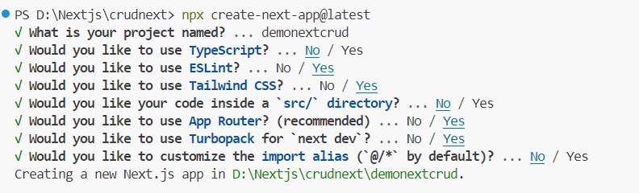
npx create-next-app@latest
Similar to web pack
It will to minifiction and zipping of your project code
npm run dev
faster coading
Create Folder component➔ for
Create Nav component and type rafce
React Arrow function component export

Slide 2
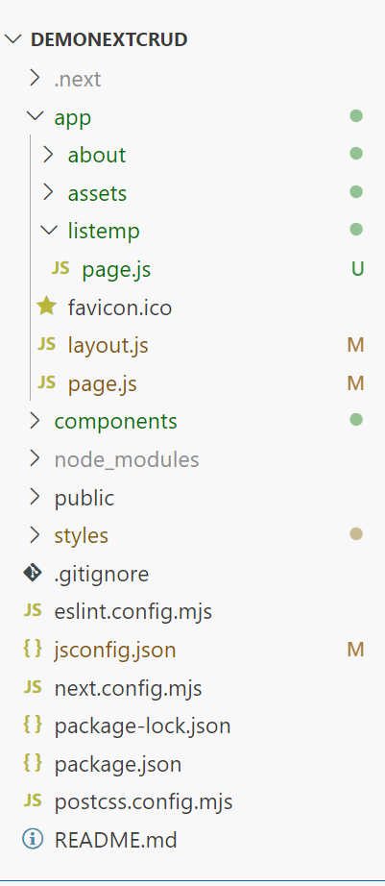
When you load application it will load layout page
in it’s children
page (home page) get loaded
To create a reusable component create a folder component and store all reusable component. Eg. Nav component .
Create a folder style to store global css.
The public folder (optional)
Create a public folder to store static assets such as images, fonts, etc. Files inside public directory can then be referenced by your code starting from the base URL (/).

Slide 3

Good to know: If you forget to create layout.tsx, Next.js will automatically create this file when running the development server with next dev.

Slide 4
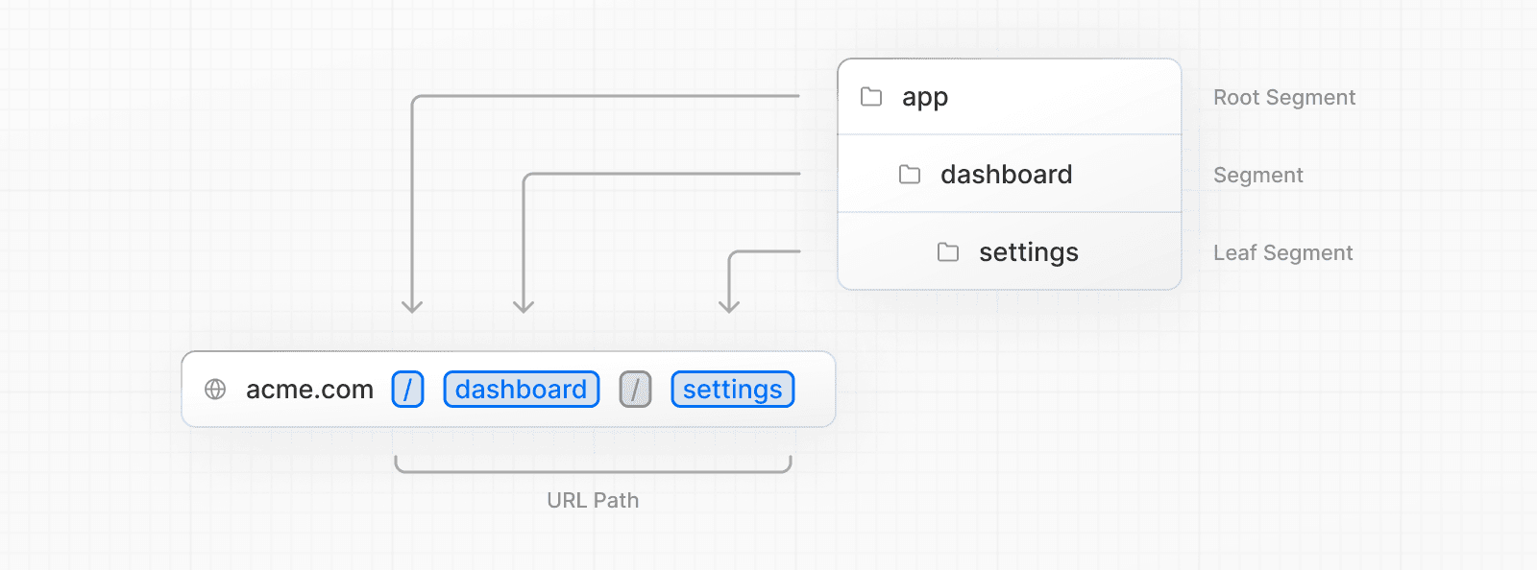
Creating Routes
Page Routing
Next.js uses a file-system based router where folders are used to define routes.
Each folder represents a route segment that maps to a URL segment. To create a nested route, you can nest folders inside each other.
Nested Route

Slide 5
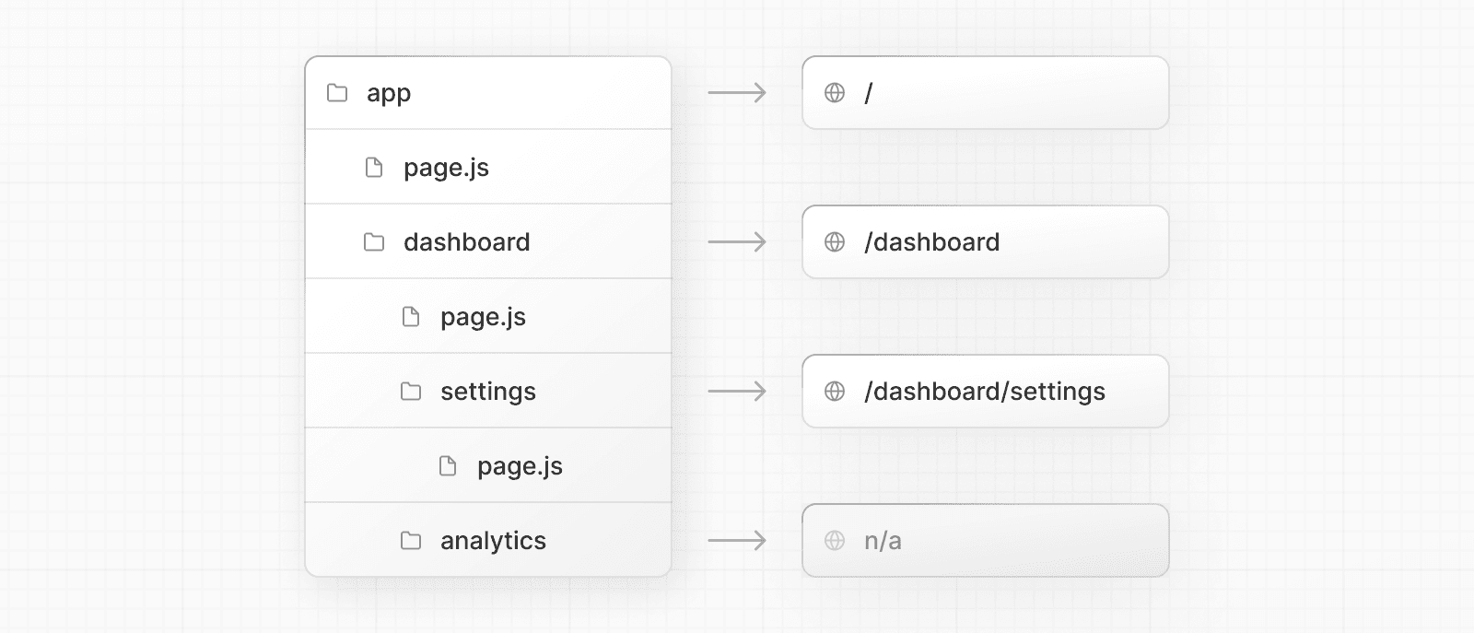
A special page.js file is used to make route segments publicly accessible.

Slide 6
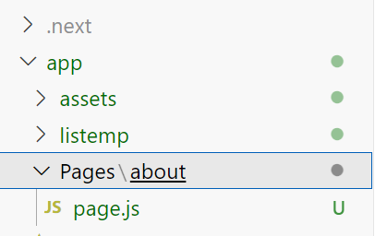
app | App Router
pages | Pages Router
public | Static assets to be served
src | Optional application source folder
Should be used on server side
If you put all page routing in pages folder then call it
http://localhost:3000/Pages/about

Slide 7
Top-level files
Top-level files are used to configure your application, manage dependencies, run middleware, integrate monitoring tools, and define environment variables.
Next.js
next.config.js | Configuration file for Next.js
package.json | Project dependencies and scripts
instrumentation.ts | OpenTelemetry and Instrumentation file
middleware.ts | Next.js request middleware
.env | Environment variables
.env.local | Local environment variables
.env.production | Production environment variables
.env.development | Development environment variables
.eslintrc.json | Configuration file for ESLint
.gitignore | Git files and folders to ignore
next-env.d.ts | TypeScript declaration file for Next.js
tsconfig.json | Configuration file for TypeScript
jsconfig.json | Configuration file for JavaScript

Slide 8
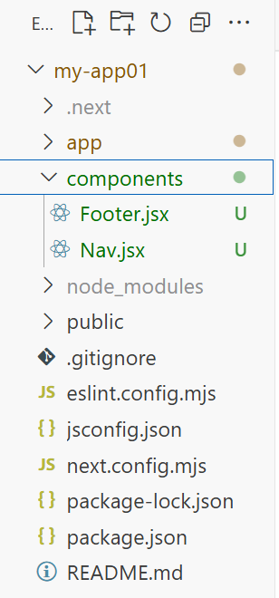
jsconfig.json
Create a folder Components in app folder
import Nav from "@components/Nav"
import Footer from "@components/Footer"
export const metadata = {
title: "Create Next App",
description: "Generated by create next app",
};
export default function MainLayout({ children }) {
return (
<html lang="en">
<body>
<main className='app'>
<Nav/>
{children}
</main>
<Footer/>
</body>
</html>
);
}
{
"compilerOptions": {
"baseUrl": ".",
"paths": {
"@*": ["./*"],
}
}
}
import Link from "next/link";
const Nav = () => {
return (
<div>
<Link href="pages/about"> About </Link> |
<Link href="/"> Home </Link> |
<Link href="/listemp"> ListEmp </Link>
</div>
)
}
export default Nav
const Footer = () => {
return (
<div>
<br/>
<br/>
<br/>
Footer Copy right SMVITA
</div>
)
} export default Footer
export default function Home() {
return (
<div>
<center>
<h1>Welcome to Next JS</h1>
</center>
</div>
);
}

Slide 9
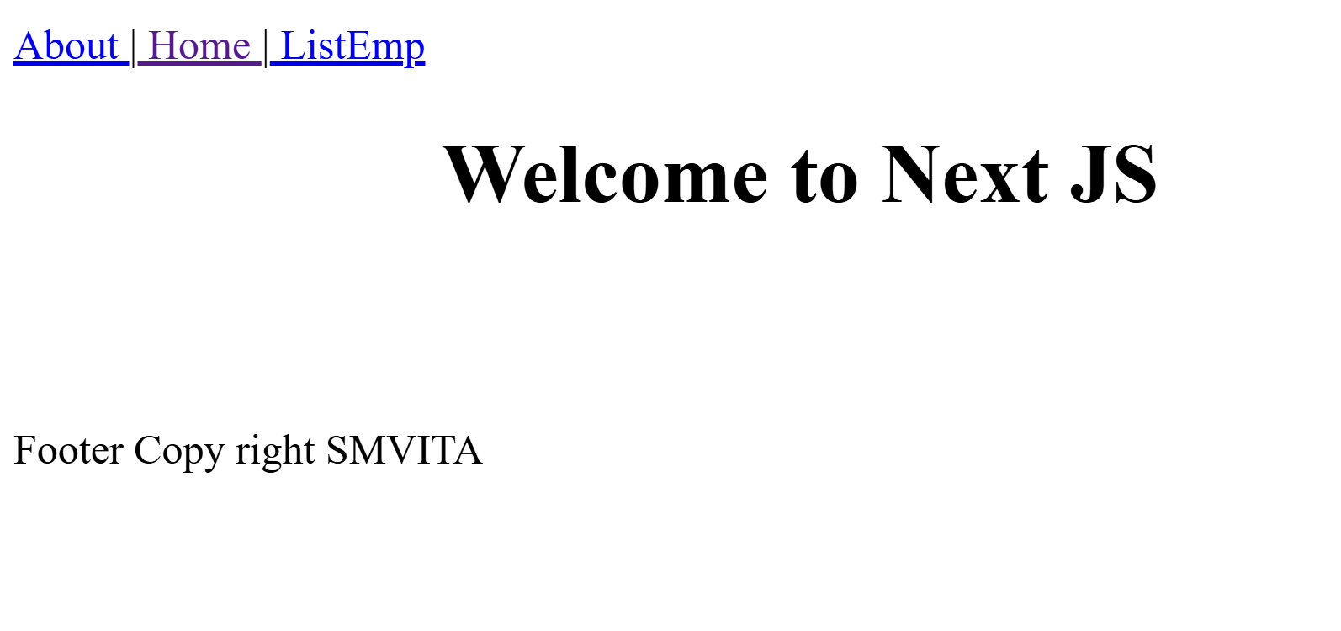
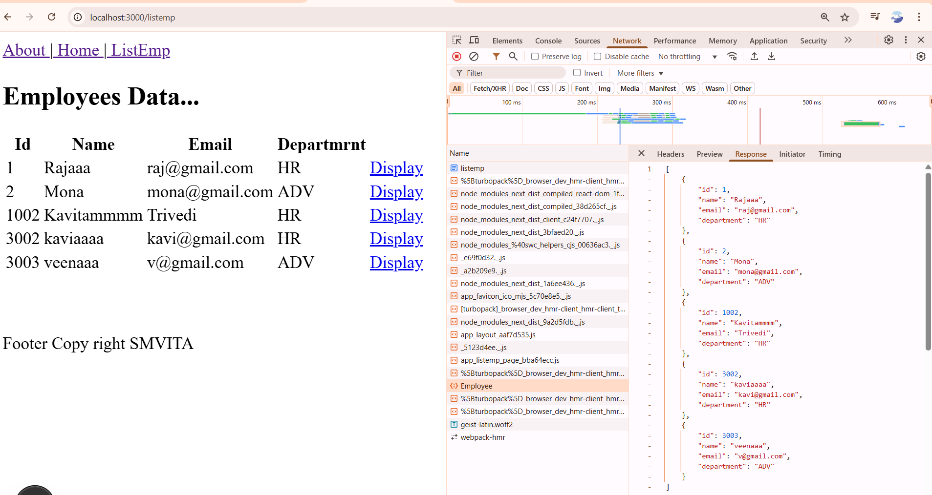

http://localhost:3000/
http://localhost:3000/listemp
http://localhost:3000/page/about
This will execute on client side but 1st it stream data on server side then it render on client side .
Due to this feature it perform much faster.
All data fetching from server should be on server side
All event associated communication should be onclient side

Slide 10
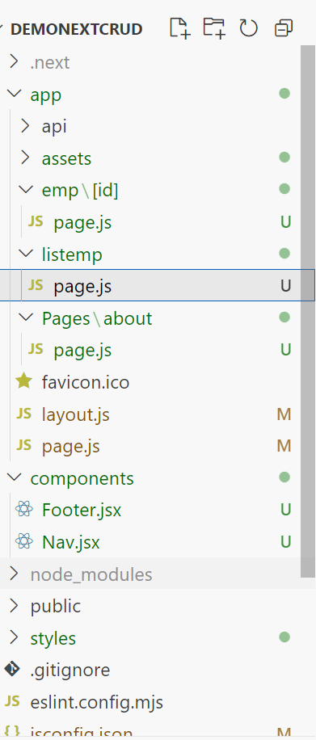
Basic Routes
'use client'
import Link from 'next/link'; import { useState, useEffect } from "react";
function Page() {
const [employees, setEmployee] = useState([]);
useEffect(() => {
fetch("http://localhost:5221/api/Employee")
.then(res => res.json())
.then((result) => { setEmployee(result); }
);
}, []);
return (
<div>
<h2>Employees Data...</h2>
<table><thead>
<tr>
<th>Id</th>
<th>Name</th>
<th>Email</th>
<th>Departmrnt</th>
</tr>
</thead>
<tbody>{employees.map(emp => (
<tr key={emp.id}>
<td>{emp.id}</td>
<td>{emp.name}</td>
<td>{emp.email}</td>
<td>{emp.department}</td>
<td><Link href={`emp/${emp.id}`}>Display</Link> </td>
</tr>
))
}
</tbody></table>
</div>
);
} export default Page;
In URL
Dynamic Route

Slide 11
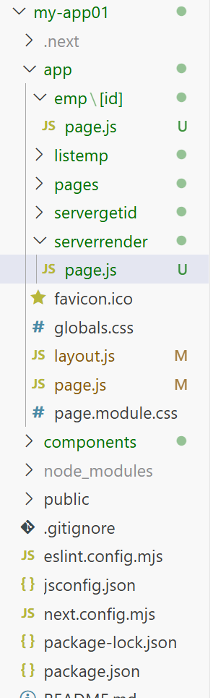
Let’s convert above code which will run on server side
import Link from 'next/link';
async function ServerExample() {
const res = await fetch("http://localhost:5221/api/Employee")
const employees = await res.json();
return (
<div>
<h2>Employees Data...</h2>
<table><thead>
<tr>
<th>Id</th>
<th>Name</th>
<th>Email</th>
<th>Departmrnt</th>
</tr>
</thead>
<tbody>{employees.map(emp => (
<tr key={emp.id}>
<td>{emp.id}</td>
<td>{emp.name}</td>
<td>{emp.email}</td>
<td>{emp.department}</td>
<td><Link href={`emp/${emp.id}`}>Display</Link> </td>
</tr>
))
}
</tbody></table>
</div>
);
}
export default ServerExample;
How do I know that it’s running on server side or client side?
By default next js execute code on server side.
If you write 'use client’
Then only it execute on client side
What is the proof?
On network tab check the type of response. If response is json data the I’s running on client side
And if response is HTML page then it’s running on server side

Slide 12
One more example of server side execution

Slide 13
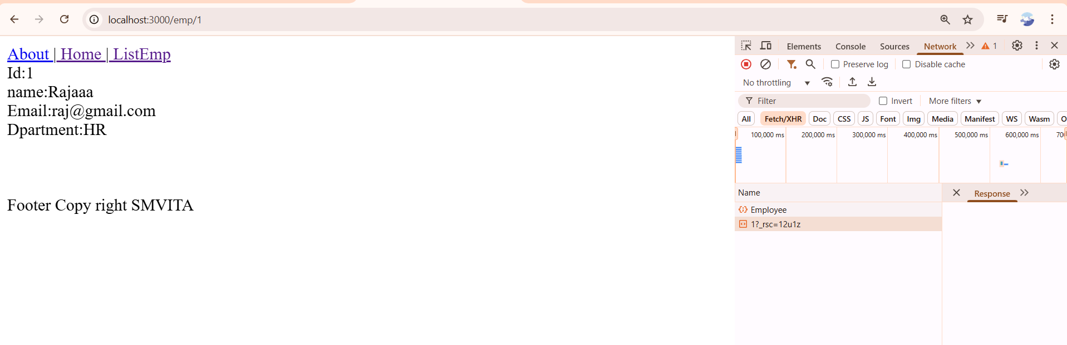
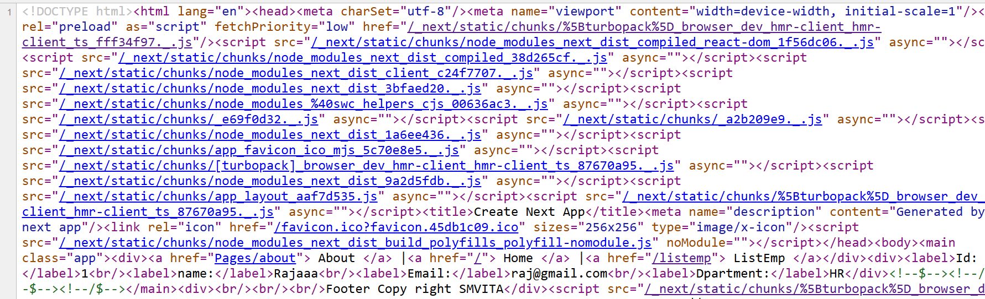
const EmployeeDetail = async ({ params }) => {
try {
// Server-side fetch (executed on the server)
const {id} = await params;
const res = await fetch(`http://localhost:5221/api/Employee/${id}`, {
cache: "no-store", // Prevents caching (useful for dynamic data)
});
if (!res.ok) throw new Error("Failed to fetch employee data");
const employee = await res.json();
return (
<div><label>Id:</label>
{employee.id}<br />
<label>name:</label>
{employee.name}<br />
<label>Email:</label>
{employee.email}<br />
<label>Dpartment:</label>
{employee.department}
</div>
);
} catch (error) {
console.error("Error fetching employee data:", error);
return <p>Failed to load employee data.</p>;
}
};
export default EmployeeDetail;
http://localhost:3000/emp/1
By default all component execute on server side and send html page=> this is node server communicate to kestrel on which .Net API runs
Name of folder
[id]
export const metadata = {
title : 'Display By Id ',
Description: 'employe details by id',
}
This will generate title for this page and meta deta for SEO

Slide 14
Somewhere in your code you used an API that opts into dynamic rendering.
Dynamic APIs are:
The params and searchParams props that get provided to pages, layouts, metadata APIs, and route handlers.
cookies(), draftMode(), and headers() from next/headers
In Next 15, these APIs have been made asynchronous.

Slide 16
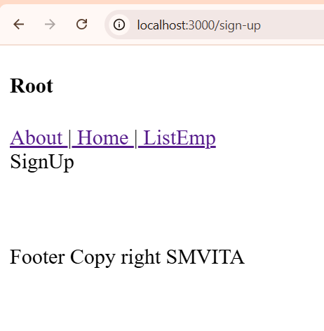
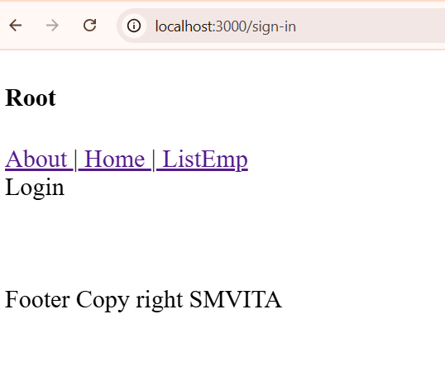
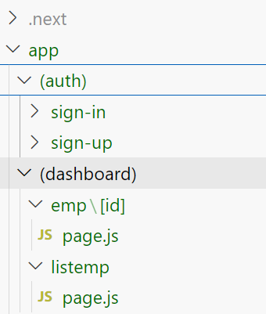
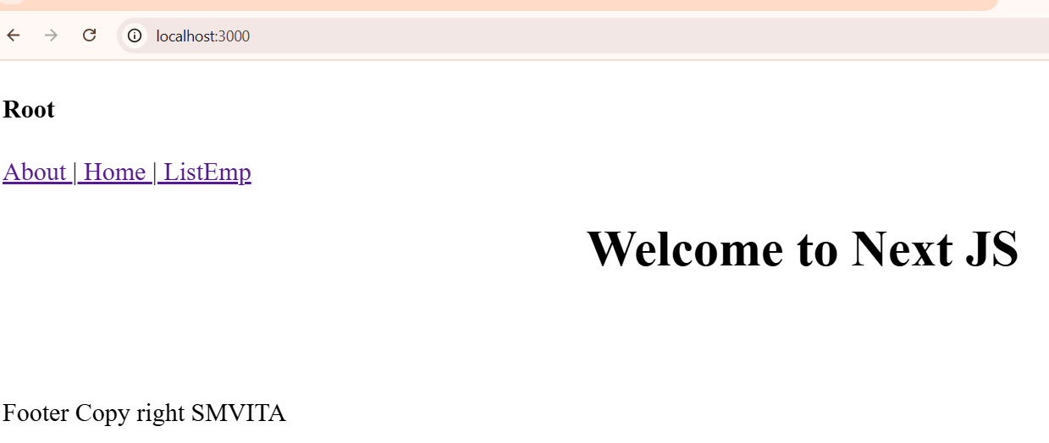
(Route Groups)
When working with a file-based system, having numerous folders within the app folder may be better, especially in a more complex system.
To address this and offer better control over folder organization without impacting the URL path structure, Next.js introduced a feature called "Route Groups.”
What if we could limit the number of folders inside the app folder to a maximum of 1-3 and include everything within these folders while maintaining the same route path?
In this case, if we create these folders, i.e., auth and, let's say, dashboard, right away and add the corresponding folders & pages inside them, it will impact our routing.
Why? Because, as we've learned, each folder
name serves as a route name.
app
auth
sign-in
page.js
page.

Slide 17
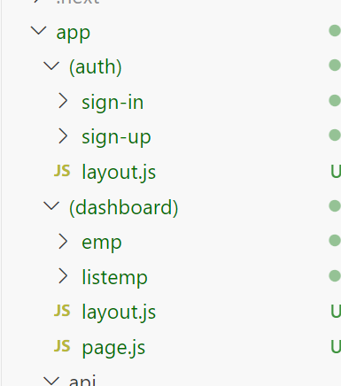
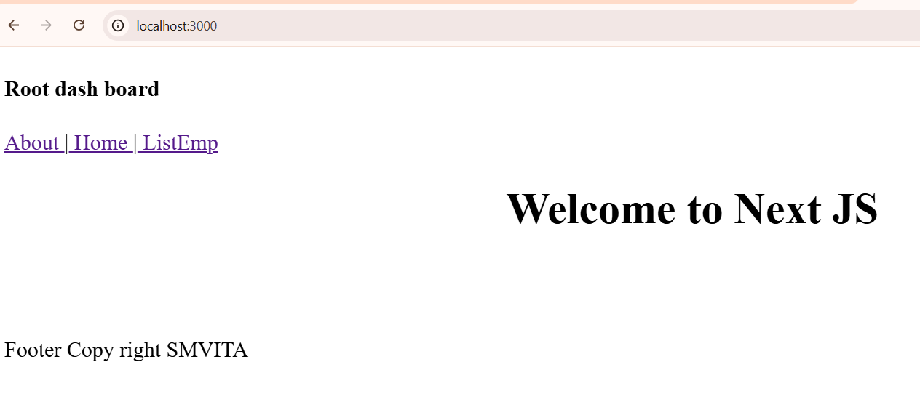
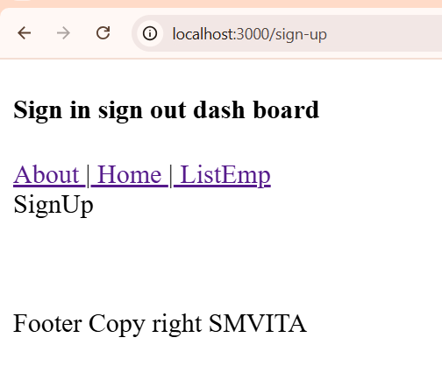
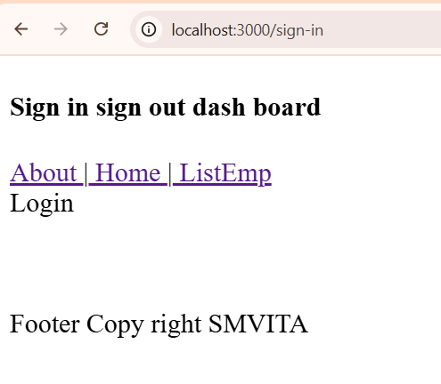
If you want two separate Layout without RootLayout you can do this. Put layout page in both folder ie. (auth) and (dashboard)
Default it will load page.js of (dashboard) folder
You can not have Page.js in both folder. it has to be in either (dashboard) or (auth)

